Slide 1
Safe At Any Speed
Designed-In Safety for the Microservices Application

Slide 2
Who are you?
Software Developer for 20 years
Worked mainly for ISVs
Reuters, SunGard, Misys, Huddle
Worked for a couple of MIS departments
DTI, Beazley
Microsoft MVP for C#
Interested in OO, SOA, EDA,, Messaging, REST
Interested in Agile methodologies and practices
No smart guys
Just the guys in this room

Slide 3

Intelligent collaboration for the Enterprise

Slide 4
Agenda
What is Availability?
Availability Tactics
Fault Recovery

Slide 5
What is Availability?

Slide 6

Faults
A fault is a defect within the system.
If unmitigated a fault can lead to failure
A software ‘bug’ is a fault
So a ‘null reference’ exception, or ‘sequence contains no elements’ exception is a fault.
An exception is a fault.

Slide 7

Error
An error is the deviation of the system from the specification.
A fault may lead to an error i.e. an error is the mechanism by which the fault becomes apparent.
i.e. an unhandled exception is a fault that has become an error.
Exception handling would mitigate a fault, and so stop it becoming an error.

Slide 8

Dormant Fault
A fault may be dormant if it does not result in an error immediately, but lies waiting.
In software this typically occurs because:
The fault is in code that has not been called.
The fault occurs under load.
The fault occurs over time i.e. a resource leak
The fault occurs from concurrency

Slide 9
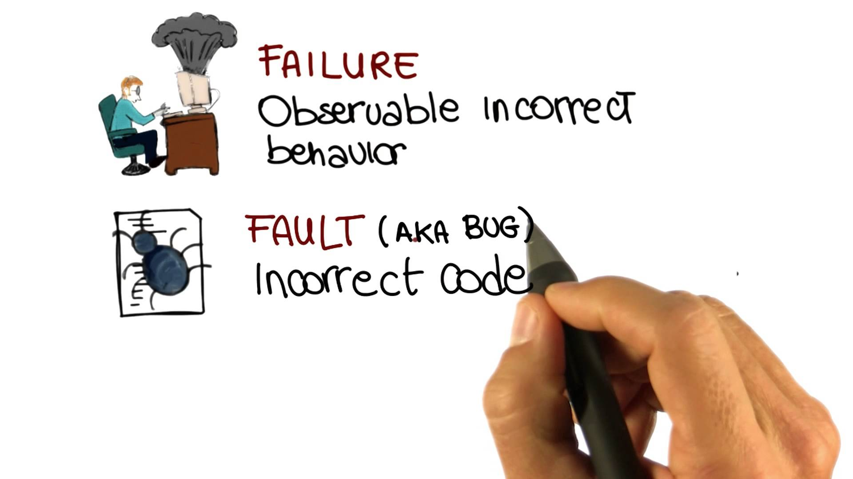
Failure
A failure is the deviation from specification of a system that is visible to a human or system observer.
An unmitigated error is the cause of a failure.

Slide 10

Availability
Availability is the property that the system can respond when required. If a system cannot respond, it is in failure.
So Availability becomes the ability of a system to mask or repair faults, such that the cumulative service outage over a given interval does not exceed a given duration.

Slide 11
Failure is to a human or system observer of the system – and is thus subjective
Availability | Downtime/year | Downtime/month | Downtime/week | Downtime/day
90% ("one nine") | 36.5 days | 72 hours | 16.8 hours | 2.4 hours
99% ("two nines") | 3.65 days | 7.20 hours | 1.68 hours | 14.4 minutes
99.9% ("three nines") | 8.76 hours | 43.8 minutes | 10.1 minutes | 1.44 minutes
99.95%* | 4.38 hours | 21.56 minutes | 5.04 minutes | 43.2 seconds
99.99% ("four nines") | 52.56 minutes | 4.38 minutes | 1.01 minutes | 8.66 seconds
99.999% ("five nines") | 5.26 minutes | 25.9 seconds | 6.05 seconds | 864.3 milliseconds
* AWS EC2 instance SLA

Slide 12
Availability Tactics

Slide 13

Prevention
Detection
Recovery

Slide 14
Fault Prevention
TDD, Pairing/Reviews, Acceptance Tests, Exploratory Testing
All help to catch defects during the SLDC
Training can create awareness of typical faults in code
But… many faults will escape these processes
Particularly Dormant Faults

Slide 15

Preventing Stealth-Mode Faults
Waking Dormant Faults
Concurrency
Resource Leaks
Data growth.
Predicting Dormant Faults
Multi-user Testing
Soak Testing
Load Testing
Notes:
Multi-user testing: Access shared resources, at the same time to prove concurrency support is to specification. Timing issues make this hard. Multi-user testing is very hard to scale.
Soak Testing: Run the system for a period of time simulating normal load. Monitor the consumption of shared resources, looking for patterns of resource leaks, noting GCs etc. Soak tests by the nature have to run for days.
Load tests: Test the desired number of users of the system and the amount of work they are performing on the system. Stress Testing is performing a load test until the system fails. Often used for capacity planning.

Slide 16
Even with these approaches, it is just fantasy to expect every single bug to be found by QA.
Faults will happen.
Notes:
A mantra is to release often, monitor and patch and re-release
A daily release strategy works well here. If you only commit 600-700 lines of code at most in a day, it’s easy to understand what broke
It’s also easy to fix, or rollback. It’s unlikely one day’s release has so much functionality that the price of rollback is an issue
(Of course if I rollback I want to avoid releasing 1400 lines tomorrow, so the priority should be to fix and re-release).

Slide 17
Fault Detection
You can’t manage what you cannot measure.
A lot of monitoring is focused on providing forensic evidence for the investigation after an incident. It is the equivalent of a black-box or flight recorder.
Monitoring key resources and transactions to understand memory, queue lengths, disk space, and head-blocking can alert operators to faults and help prevent them becoming errors, or errors becoming failure.

Slide 18
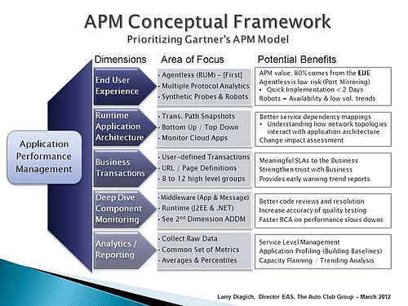
Application Performance Management
APM tools provide a ‘real-time’ view of a system.
End-User Experience
Business Transactions
Deep-Dive Component Framework
Also tend to provide
Resource Monitoring
Alerts

Slide 19
Fault Recovery
If you cannot eliminate faults your only choice is to survive them.
The primary concern when surviving a fault is to prevent the propagation of that fault beyond the system it occurs in to other systems.
In microservices architectures, where you may have services that depend on other services for their availability you need to ensure that a fault does not propagate to those dependant services.
You must not allow faults to become cascade failure.
Resilience is the ability of a system to remain available in the face of faults.

Slide 20
Cascade Failure
Within a distributed system, a fault may not be in a part of the system observable by a user, but is observable by other systems.
Assume we have System A and System B and B depends on A.
If a fault occurs in A, and is not handled it becomes an error, which if unmitigated causes A to fail.
The failure of A becomes a fault for B.
If B does not handle that fault, it becomes an error which if unmitigated causes B to fail.
In this way we say that a failure can cascade.

Slide 21
United Airlines Flight 232
A DC-10 that on July 19, 1989 crash-landed in Sioux City, Iowa
A fatigue crack occurred due to stress in the fan of tail-mounted GE engine.
The fan’s failure was catastrophic and uncontained and high-speed metal fragments penetrated three hydraulic lines.
The loss of hydraulic fluid led to the collapse of the hydraulic system of the plane.
The aircraft had no working control surfaces: flaps and slats
The crew attempted to recover by varying engine throttle on the two remaining engines to steer.

Slide 22


Slide 23
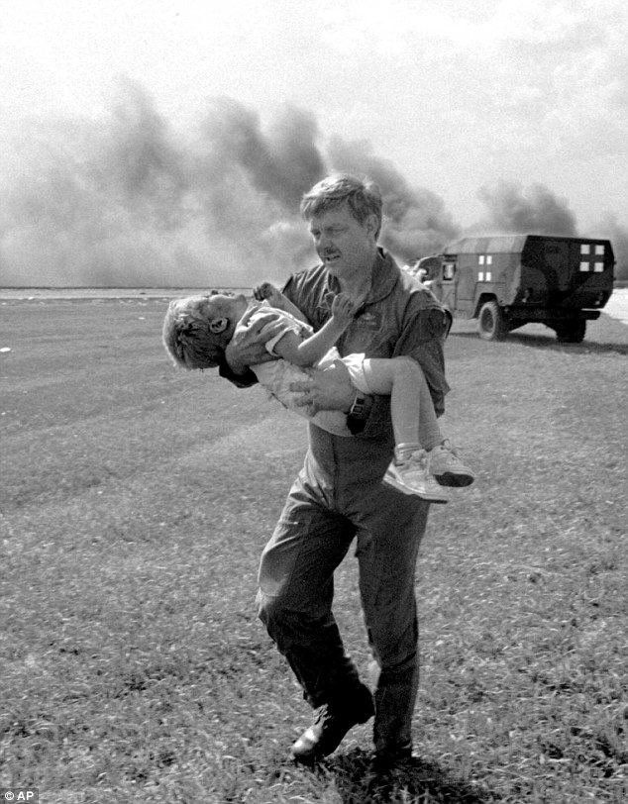
Sioux City Air Crash
Of the 296 people on board, 111 died in the accident and 185 survived
Captain Al Haynes became a hero.
40 subsequent attempts to re-create Captain Haynes’s & crew flying a plane with no control surfaces in simulators all failed.
It is known as “The Impossible Landing.”
Lt. Colonel Dennis Nielsen carries Spencer Bailey to safety
Notes:
When the Colonel was called a hero, he responded with "God saved the child. I just carried him.“
One attempt at flying the plane in a simulator succeeded – ending in a fatal crash.

Slide 24
Fault Recovery

Slide 25

Timeouts
Context and Problem
Timeouts are a scaling issue.
Operations without timeouts that fault leak resources.
Eventually your system becomes resource starved and fails.
Notes:
Context and Problem
Timeouts are a scaling issue. Because an API call without a timeout consumes resources, a stalled network call, or thread, prevents other requests from being executed. You might not notice the failure to use timeouts on a system with abundant resources, but as your resources dwindle failure to use timeouts to free resources will cause pain.
Assume that the need to timeout will occur at some point
Asynchronous operations still need to time out. All the caller may not be blocked, resources are still being consumed to manage the asynchronous operation that will not be released until the operation aborts.

Slide 26
DIAGRAM: A web server A and B. Actor talking to A. B talks to DB. Fault between B and DB. Next slide. Fault between A and B as B becomes resource starved to service requests. Next slide fault between A and actor as A becomes thread starved. Next slide show that timeouts => B to Db, A to B, Actor to A could have formed a bulkhead that prevented the fault cascading into failure.

Slide 27
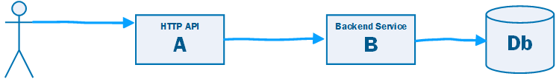

Slide 28
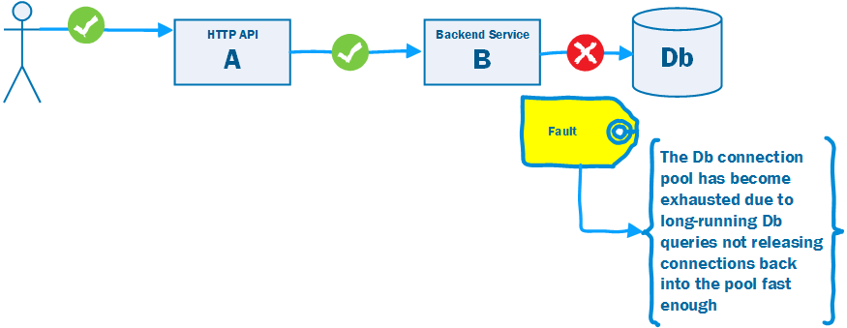

Slide 29
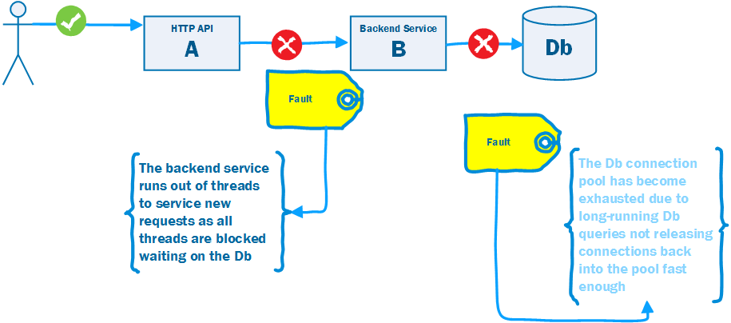

Slide 30
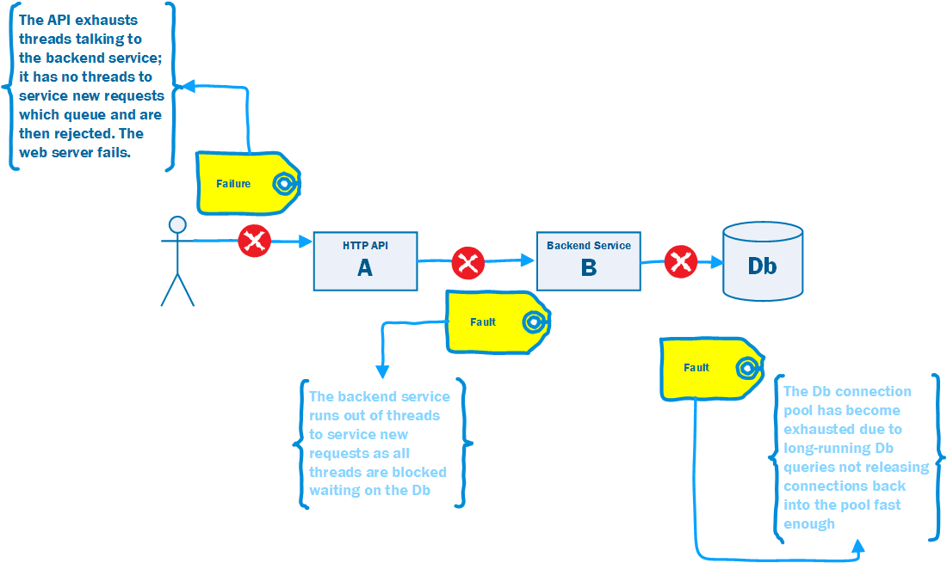

Slide 31
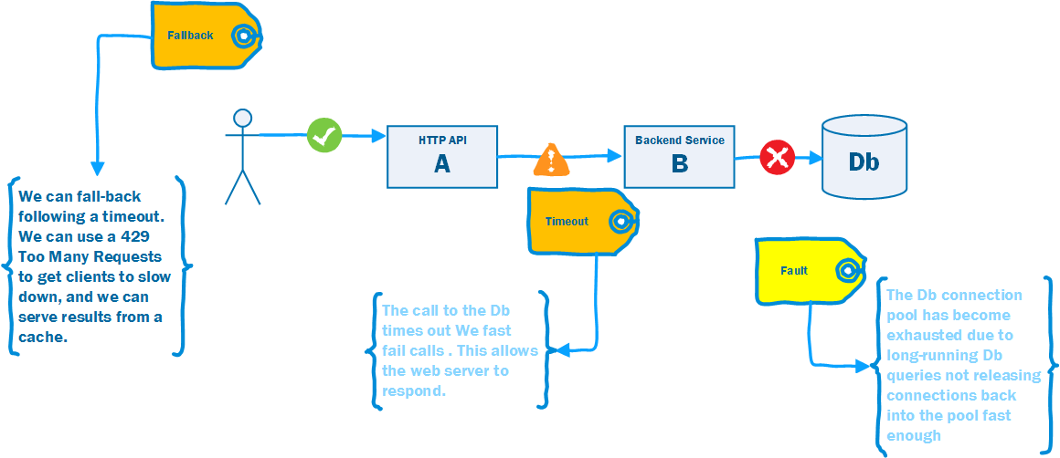

Slide 32
The Timeout Pattern
Solution
Provide a timeout on any inter-process operation.
Any operation that blocks a thread, should have a timeout
Usually a timeout is a parameter on an API call that indicates how long to wait for the operation to complete before returning control to the caller
If you are using an API that has no timeout, make the request on a thread that does have a timeout, and when that thread times out assume that the operation failed.

Slide 33

Retry
Context and Problem
Many faults are transient.
In this case the fault is self-correcting. This means that our call will succeed if we retry after a delay.
Notes:
Context and Problem
In the presence of unreliable calls between two components our first approach to achieving a high quality of service is to recognize that many such failures are transient: a timeout because a resource is busy, temporary loss of connectivity, the loss of one node that will be replaced by failover to another.
In this case the fault is self-correcting, the node comes up, the load on the database or server declines and their is capacity for our call, or network connectivity is restored. This means that our call will succeed if we retry after a delay to allow the transient fault to resolve.

Slide 34
DIAGRAM: Retry as a diagram. Use the diagram sequence from Timeout but failure is intermittent – a deadlock. But show that if we retry the operation between B and DB or A and B, or Actor and A (after the timeout) a transient fault can be corrected, so the user does not experience the fault.

Slide 36
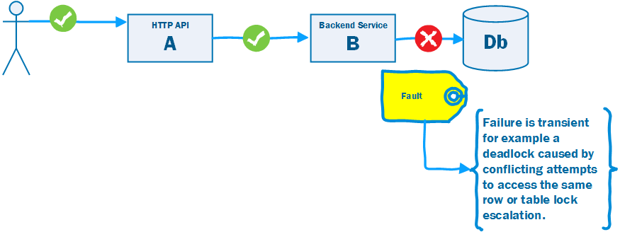

Slide 37
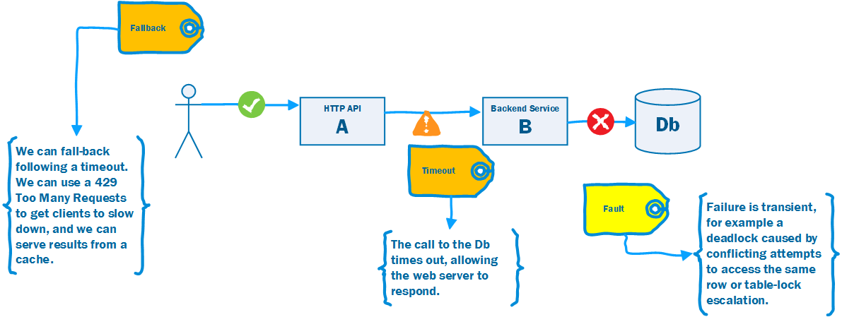

Slide 38
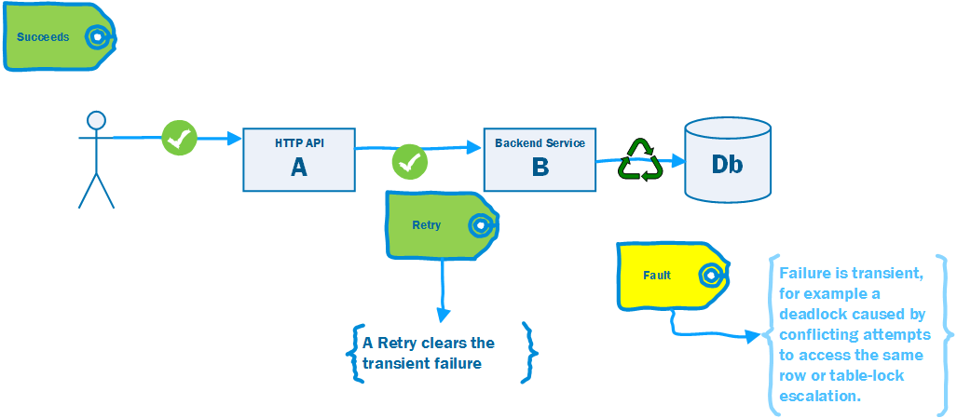

Slide 39
The Retry Pattern
Solution
The Retry pattern is simple: if the call fails, try again.
It is important to have an upper bound on retries in case a fault that appears transient is not.
If the fault is caused by a rare event, retry without delay.
If the fault is caused by load back-off before retrying.
If the fault is permanent don’t retry.
Notes:
Solution
The Retry pattern is simply that if the call fails, we can try again. It is important to have an upper bound on retries in case a fault that appears transient is not.
If the fault is caused by a rare event, for example packet loss or other corruption, consider an immediate retry as the server may be able to respond.
If the fault is caused by load, such as SQL Timeouts, or 429 Too Many Requests, then back-off for a period before retrying. Failure to observe this can lead to an Application Denial of Service Attack i.e. we overload a struggling server.
If the fault is permanent, and unlikely to succeed, for example a login failure due to invalid credentials – don’t retry.

Slide 40

Circuit Breaker
Context and Problem
Transient faults can be handled by a retry.
Some faults are not transient. Retry may be pointless in this context.
Faults can cascade to failures.
Notes:
Context and Problem
Fault that typically correct themselves after a short period of time can be handled by a Retry.
Some faults are not transient – such as a complete loss of a service or network connectivity and may take longer to resolve. Retry may be pointless in this context.
Failures can cascade. For example, a timeout strategy will consume resources on the caller – if it has failed and will not respond – the queueing calls may cause resource exhaustion on the caller

Slide 41
DIAGRAM: Circuit Breaker as a diagram. Use the diagram sequence from Timeout. But show that if the Db error is not short i.e. cluster failover and we retry the operation between A and B, or Actor and A (after the timeout) we risk creating a fault by consuming resources and queuing as we wait for the Db to fail over. In this case break the circuit and handle a fallback (by using cached data, busy message and 429) etc.

Slide 46
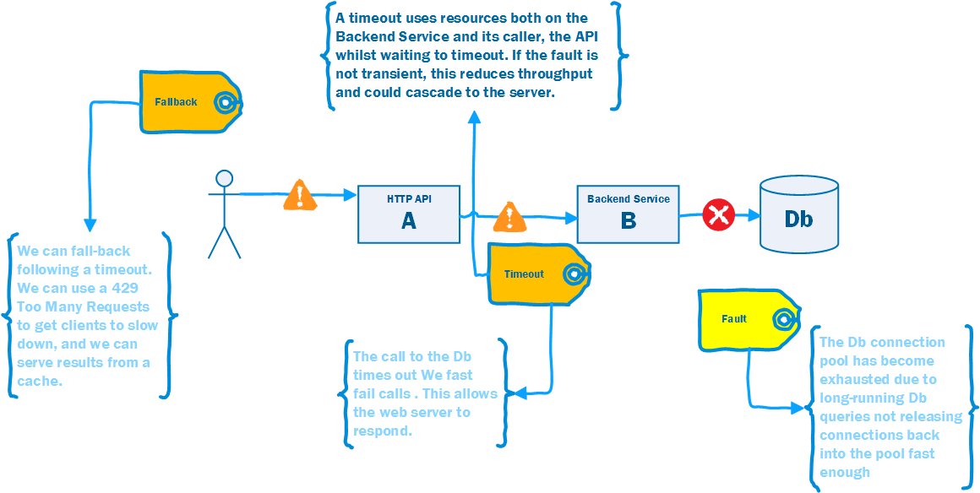

Slide 47
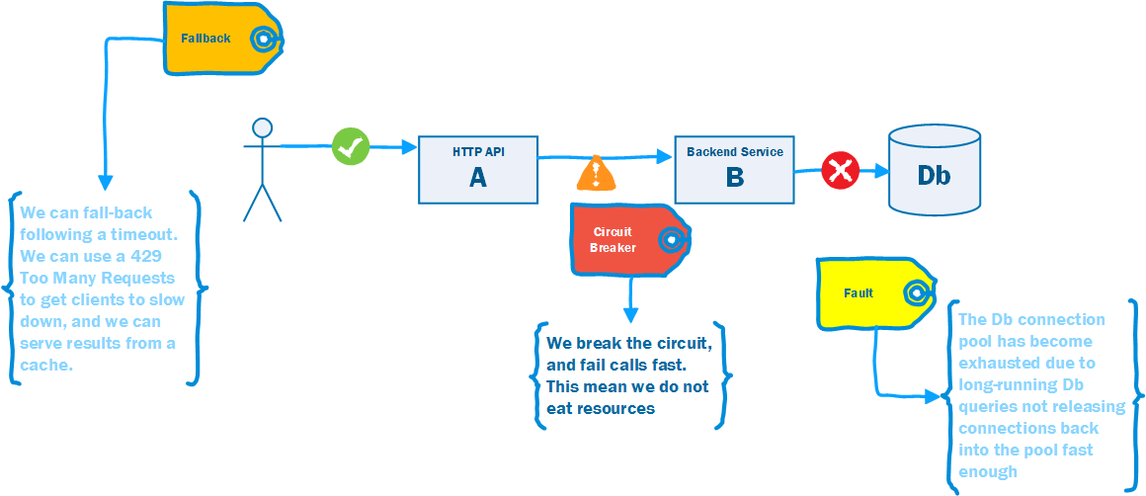

Slide 48
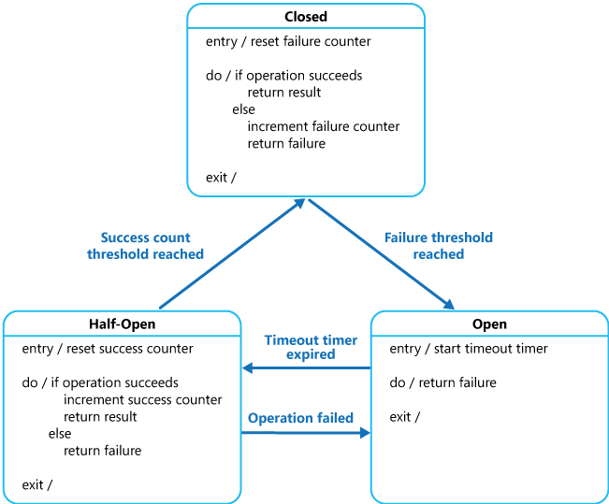
https://msdn.microsoft.com/en-us/library/dn589784.aspx
Notes:
Closed: Requests are routed as normal, on a failure a counter is incremented and if the threshold is exceeded within a time limit, the circuit breaker opens.
Open: No calls are allowed, and are failed automatically by the proxy. After a specified time interval the circuit breaker is moved to half-open
Half-Open: A call is allowed. On a failure the breaker moves to Open, on a success it moves to Closed

Slide 49
Circuit-Breaker Pattern
Solution
The Circuit Breaker pattern prevents an application from executing an operation that is likely to fail, thus freeing up resources that would otherwise be consumed waiting for a timeout and retry cycle to occur.
Once normal service has been restored to the server or resource pool the circuit breaker pattern allows detection of the resumption of service.

Slide 50

Throttling
Context and Problem
Consumers do not use application resources evenly, instead there may be peaks and troughs.
Peak demand may beyond the limits of the available resources, causing a fault.
That fault will become a failure by cascade.
Notes:
Consumers do not use application resources evenly, instead there may be peaks and troughs.
The application itself, by notifying users, may create its own peaks.
Peak demand may beyond the limits of the available resources.
Fixed capacity for unusual bursts may be too expensive to keep idle.
Elastic compute may not be available/takes too long to come on line.
Peak demand may represent unusual traffic from ‘machine actors’ as opposed to ‘human actors.’

Slide 51
TODO: Have a service A that calls B that calls a Db. Next picture service faults due to unbounded request of B against Db. Service goes into GC collect. Next diagram calls to B queue as it collects. Next diagram A faults to actors as cannot talk to B. Next show diagram with B refusing operation as it exceeds limits set for that operation.

Slide 53
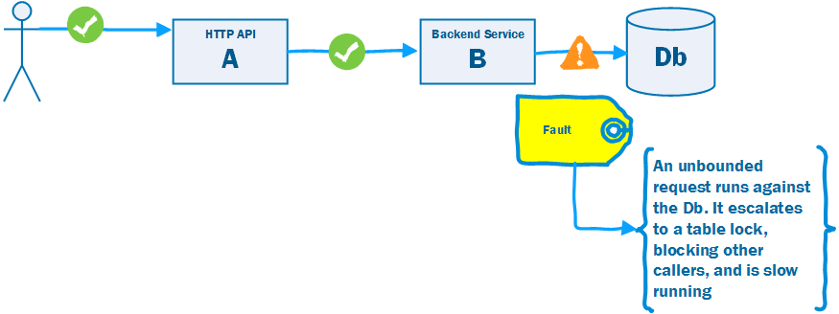

Slide 54
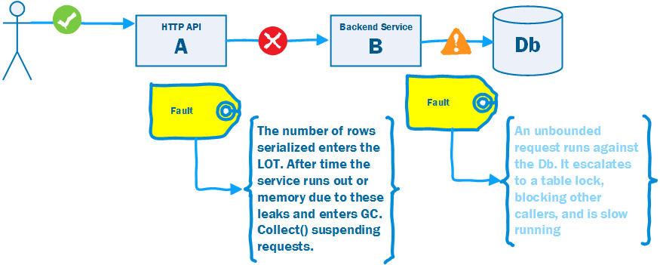

Slide 55
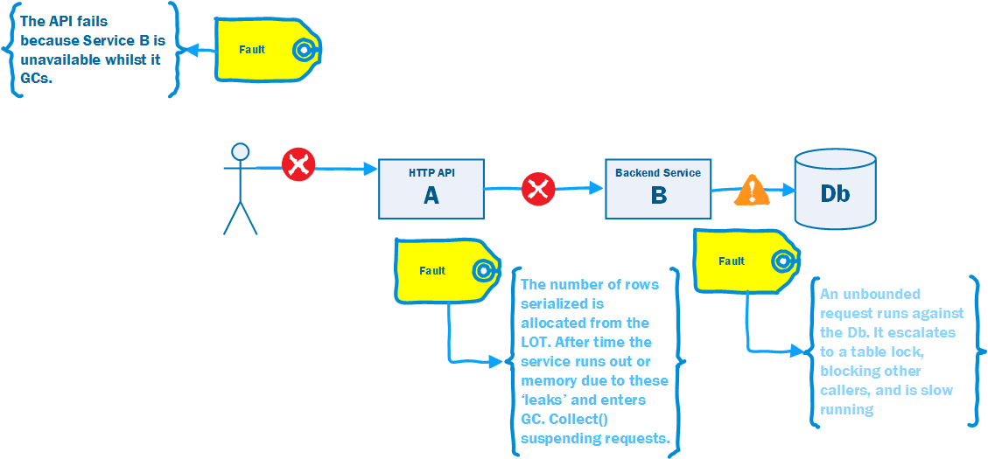

Slide 56
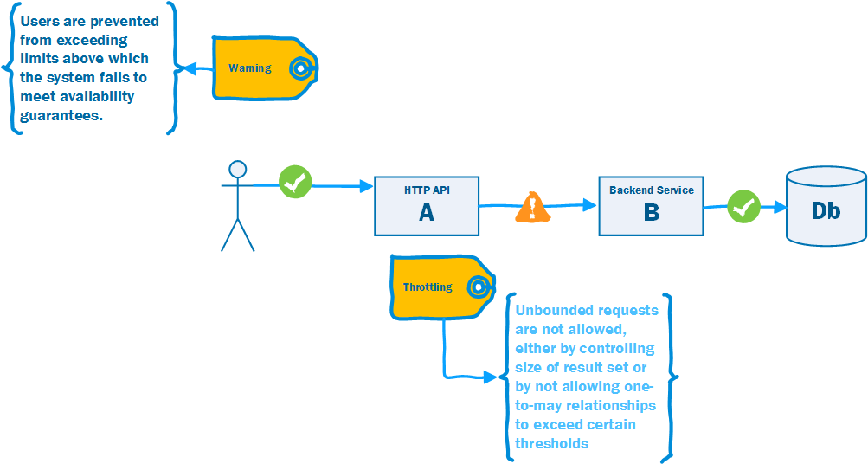

Slide 57
Throttling Pattern
Solution
Allow applications to only uses resources up to a ‘soft limit.’
Constrain fan-out relationships to prevent them from exploding.
Notes:
Allow applications to only uses resources up to a ‘soft limit.’ Once that limit has been passed, restrict the resources available to applications.
API rate limiting a common example of throttling.
But functional degradation once limits exceeded not unusual i.e. these ‘expensive’ features are no longer available to you.
Constrain fan-out relationships such as one-to-many to prevent them from exploding. Code should limit the number of ‘children’ in such a relationship. A hard limit prevents adding them, a soft limit degrades functionality when you do.

Slide 58

Decoupled Invocation
Context and Problem
An application may experience peaks of demand that cause it to become overloaded and unable to respond.
It could be that part of the application itself becomes overwhelmed or one of its dependencies becomes overwhelmed.
Notes:
Context and Problem
An application may experience peaks of demand that cause it to become overloaded and unable to respond.
It could be that part of the application itself becomes overwhelmed – due to a lack of CPU or memory – or it could be that the application depends on a third-party service that can become overwhelmed.
For example, there is a limited number of connections in a database connection pool. Long-running queries can lead to a lack of available connections to service requests. These requests in turn back up and overwhelm a server’s thread pool. This can cause queueing of requests on the server. Eventually the server stops serving requests.
“Done well, middleware simultaneously integrates and decouples systems. It integrates them by passing data and events back and forth between the systems. It decouples them by letting the participating systems removing specific knowledge of and calls to the other systems. Since integration points are the number-one cause of instability, this looks like a good thing.”
“Any kind of synchronous call-and-response or request/reply method forces the calling system to stop what it’s doing and wait. In this model, the calling system and the receiving system must both be active at the same time—they are synchronous in time—though they may be in different places. This category covers remote procedure calls (RPC), HTTP, XML-RPC, RMI, CORBA,
DCOM, and any other analog of local method calls. Tightly coupled middleware amplifies shocks to the system. Synchronous calls are particularly vicious amplifiers that facilitate cascading failures.”

Slide 59
DIAGRAM: Have a service A that calls B that calls a Db. Next picture service Db faults due to connection pool limit. B faults due to queueing waiting for the Db. A faults waiting for B. Now show a queue between A and B. Show that B can throttle the rate it reads from the queue to stay within limit of the Db connection pool.

Slide 64
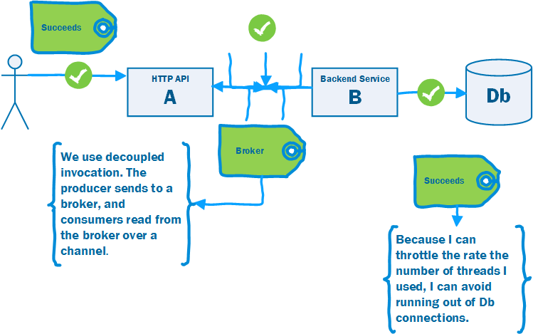

Slide 65
Decoupled Invocation Pattern
Solution
Use Decoupled Invocation. A producer puts a message onto a queue at the service endpoint. A consumer reads messages from the queue.
The queue stores messages for eventual processing. If the queue is durable we gain guaranteed delivery, and at-least once guarantees.
If the rate of arrival at the endpoint is unpredictable, the queue acts as a buffer that makes it possible to predict the rate of consumption.
This makes it simpler to do capacity planning because peaks of requests are smoothed out by the queue.
The consumer must be able to control the rate of processing, otherwise a spike is simply passed down the wire.
Notes:
As illustrated in figure 3.3, the Decoupled Invocation pattern is composed of three basic components: a handler, a queue, and a dispatcher that mediates between them. Here’s how the initial request processing works:
The handler listens for incoming requests from the endpoint.
When a new request arrives, the handler sends an acknowledgment to the sender.
The handler is responsible for the initial treatment, or preprocessing, of incoming messages. This may include message transformation or prioritization based on knowledge it infers from the messages themselves. Overall, this processing should be kept minimal, as the goal is to quickly queue and acknowledge incoming requests.
The message is put onto a queue.
The queue, which is the second component of the Decoupled Invocation pattern, stores incoming messages and allows the service to consume the messages at its own steady rate, thus overcoming peak loads.
You can set up the queue to be persistent so the service won’t lose any requests it has already acknowledged, even if a catastrophic server failure occurs. If the queue is transactional, you can also implement the Transactional Service pattern (see chapter 2) and increase the overall robustness of the service even further.
The dispatcher is responsible for creating as many reader components as are needed for the current request load, which is measured by the number of messages waiting in the queue. The dispatcher can also prioritize incoming tasks based on internal considerations, such as resource availability. The dispatcher is a good place to introduce elasticity if the latency of handling the messages is important. (See also the further reading section for an article on the LMAX architecture, which describes a low-latency, high-performance queue between senders and receivers.)
The handler can acknowledge the request as part of the preprocessing, but it’s usually best to do this inside an edge component (see the Edge Component pattern in chapter 2). This helps ensure that the service-processing load is kept to a minimum, allowing the handler to process requests as efficiently as possible.
Placing requests on the queue is a relatively low-cost operation that can be performed efficiently, making the initial request-handling less susceptible to failure during peaks (as compared to other parts of the request-handling that require more time and resources). The actual handling of the incoming requests can be performed at a reasonable pace, dictated by service resource availability and overall load. Load balancing can be achieved by running multiple readers against the queue.

Slide 66

Competing Consumers
Context and Problem
We use decoupled invocation but cannot process the messages fast enough and we have high latency.
Eventual consistency at high latency looks like network partition
In addition a single consumer is bad – if it fails that failure cascades to callers.
Notes:
Context and Problem
We may decide to move to using a task queue to offload work from an endpoint – to smooth our peaks and troughs or avoid chain failure where resources on the endpoint queue waiting for other services or processes.
If we cannot process messages on the work queue fast enough we can run in to other difficulties
Eventual consistency at high latency looks like network partition
The workload on the queue may be uneven – particularly when the queue is used to throttle requests from the endpoint. Under normal load a single consumer may be enough, under peak load it may not.
A single consumer is bad; active-active may be better than active-passive.

Slide 67
Competing Consumers Pattern
Solution
Increase the number of consumers reading messages from the queue. The message queue must hand a message to only one consumer. It must allow waiting consumers to read messages further down the queue if the message at the top is locked.
Ordering is an issue as consumers run at different rates. Two main solutions:
Sorting into order, using the queue, not processing out of order. This can be less performant than having no competing consumers.
Ensure messages can run when out-of-order i.e. idempotency
Highly Scalable, particularly with elastic compute – just add consumer nodes.

Slide 68
DIAGRAM: Have a service A that calls B that calls a Db using middleware for decoupled invocation. Next picture queue backs up because we can’t read messages fast enough. Front end experiences a partition as latency increases. Now show a queue between A and B with multiple consumers that can process messages fast enough to keep up.

Slide 69
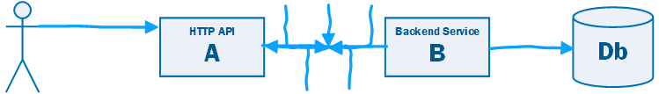

Slide 70
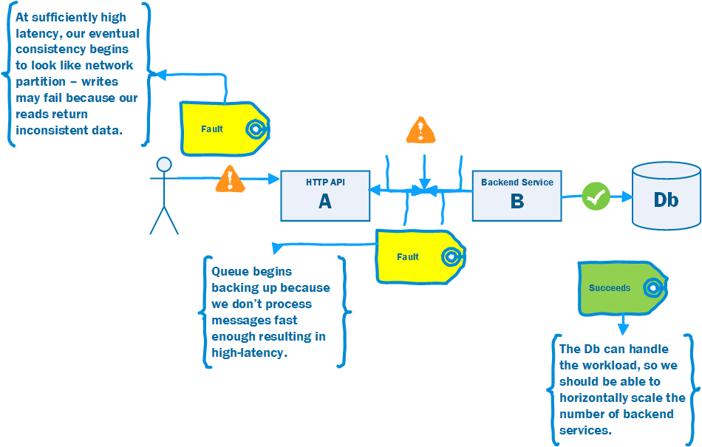

Slide 71
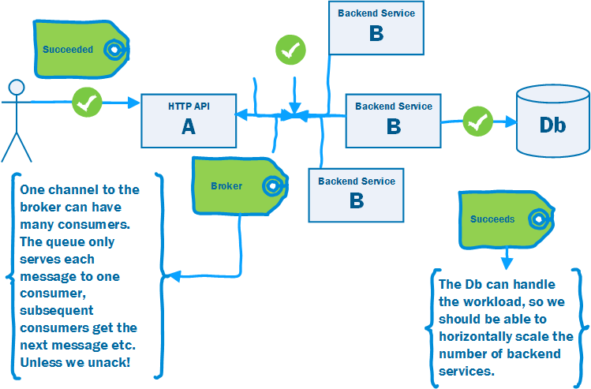

Slide 72
Parallel Pipelines Pattern
The Parallel Pipelines Pattern uses a Pipes and Filters approach to Decoupled Invocation.
The task is broken into sub-tasks or filter steps. Usually by the first consumer.
Communication between filter steps is by a message queue, each filter step runs as an independent process.
A filter step may use the competing consumers pattern – so resources can be tailored to the needs of each step.
Monitoring the queue length indicates the performance of relative steps, helping to identify bottlenecks.
Note that overall latency is increased, you have multiple queues, but you benefit in throughput.

Slide 73

Parallel Pipelines
Context and Problem
If the time taken for a consumer to process a given task is long, there are negative consequences.
It is difficult to understand progress.
Scaling becomes ‘all or nothing.’
Notes:
Competing Consumers help you increase throughput, but if the time taken for a consumer to process a given task is long, then there are negative consequences.
The queue backs up, leading to high latency, which appears as partition.
It is difficult to understand progress, and thus predict how long we will have high latency, because the long running job puts us ‘in the dark’ from the perspective of queue monitoring tools.
Scaling becomes ‘all or nothing’ as we have to add new consumers of the whole task, even if the bottleneck is part of the task.

Slide 74
DIAGRAM: Have a service A that calls B that calls a Db using middleware for decoupled invocation. Next picture queue backs up because we can’t process message fast enough – its performing a lot of Db operations. Front end experiences a partition as latency increases. Now show B divided into B, C, and D with a queue between all the parts and multiple consumers against one stage that can process messages fast enough to keep up.

Slide 76
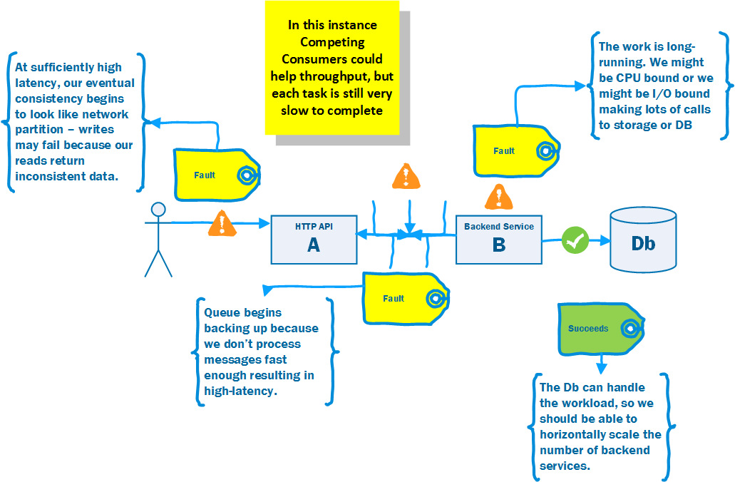

Slide 77
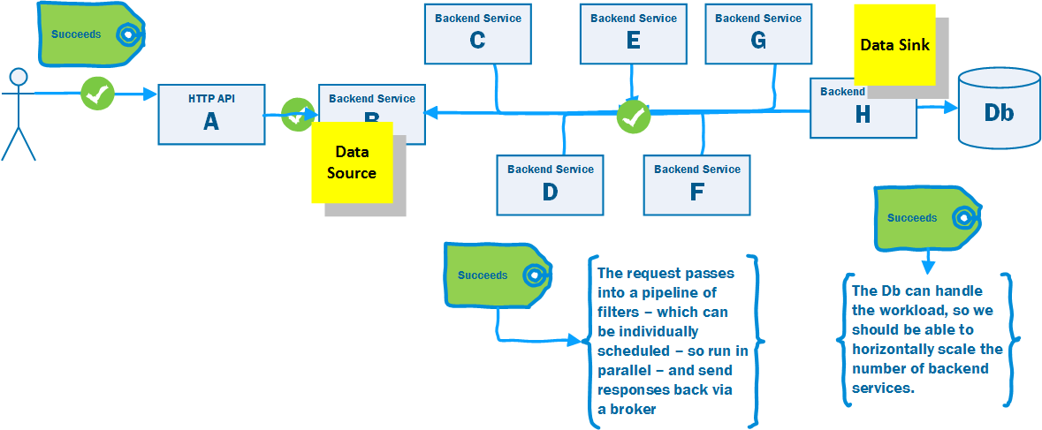

Slide 78
Parallel Pipelines Pattern
The Parallel Pipelines Pattern uses a Pipes and Filters approach to Decoupled Invocation.
The task is broken into sub-tasks or filter steps. Usually by the first consumer.
Communication between filter steps is by a message queue, each filter step runs as an independent process.
A filter step may use the competing consumers pattern – so resources can be tailored to the needs of each step.
Monitoring the queue length indicates the performance of relative steps, helping to identify bottlenecks.
Note that overall latency is increased, you have multiple queues, but you benefit in throughput.

Slide 79
Further Reading

Slide 80

Release It!
Michael T Nygard
Source of many of the Stability Anti-Patterns and Patterns in this presentation

Slide 81

SOA Patterns
Arnon Rotem-Gal-Oz
Fundamental Patterns for SOA (and by inference Microservice) architectures.

Slide 82
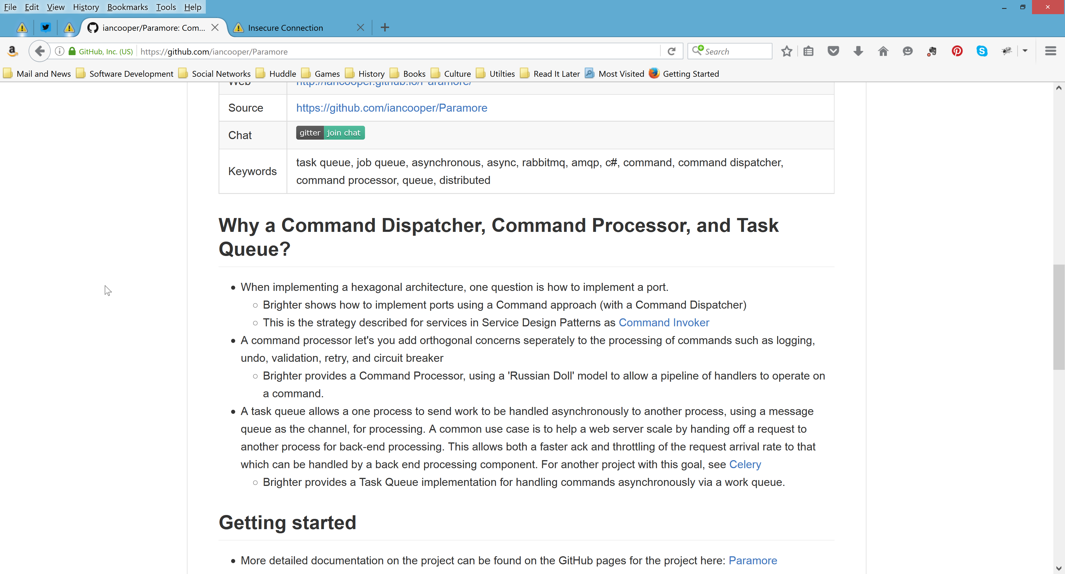
Brighter

Slide 83
Summary

Slide 84
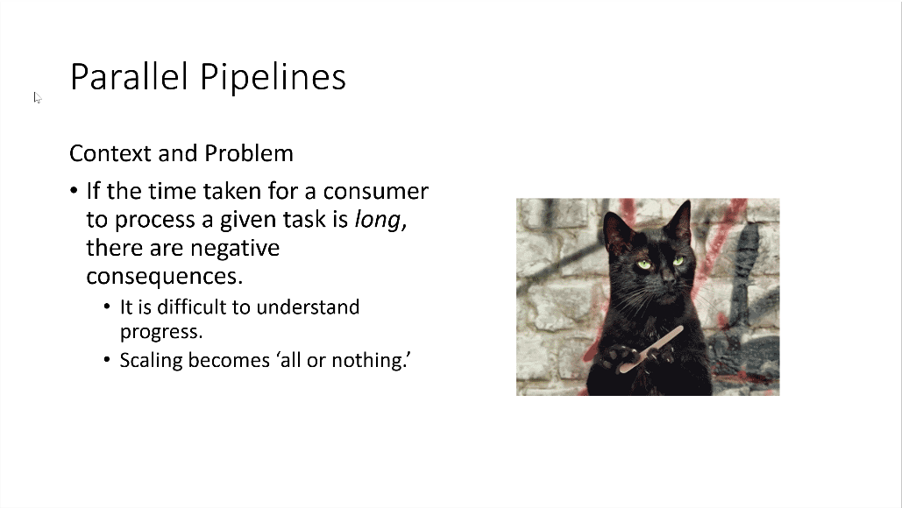
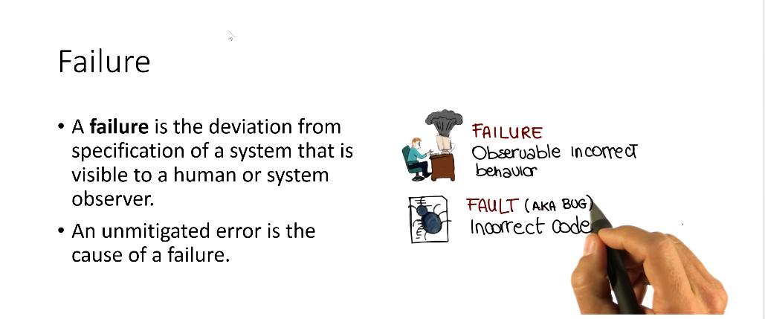
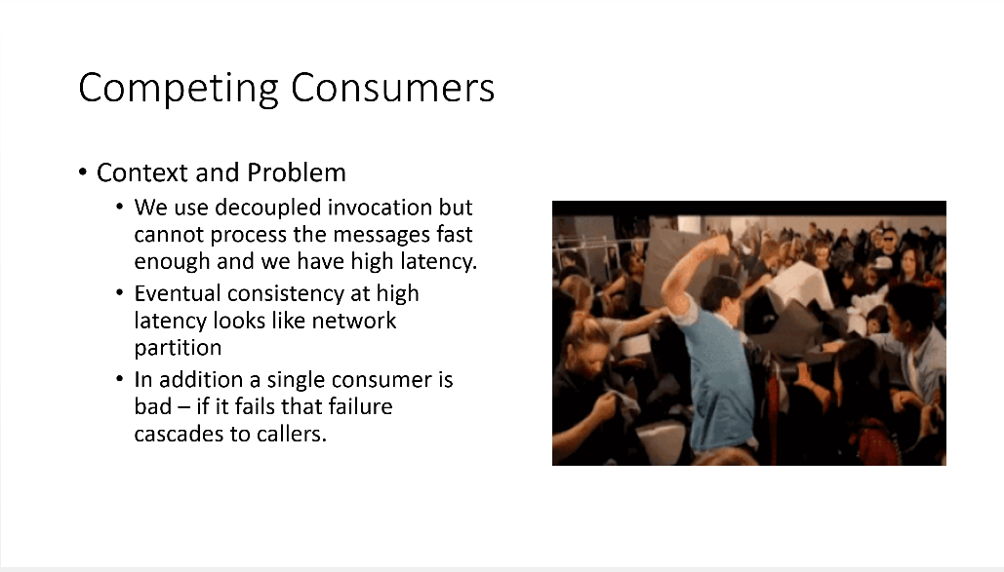
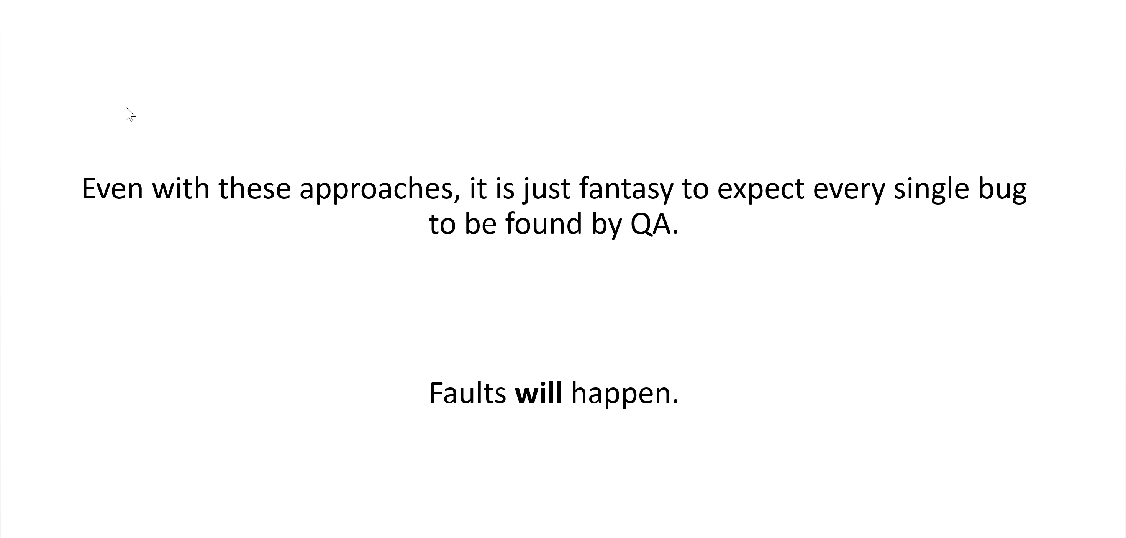
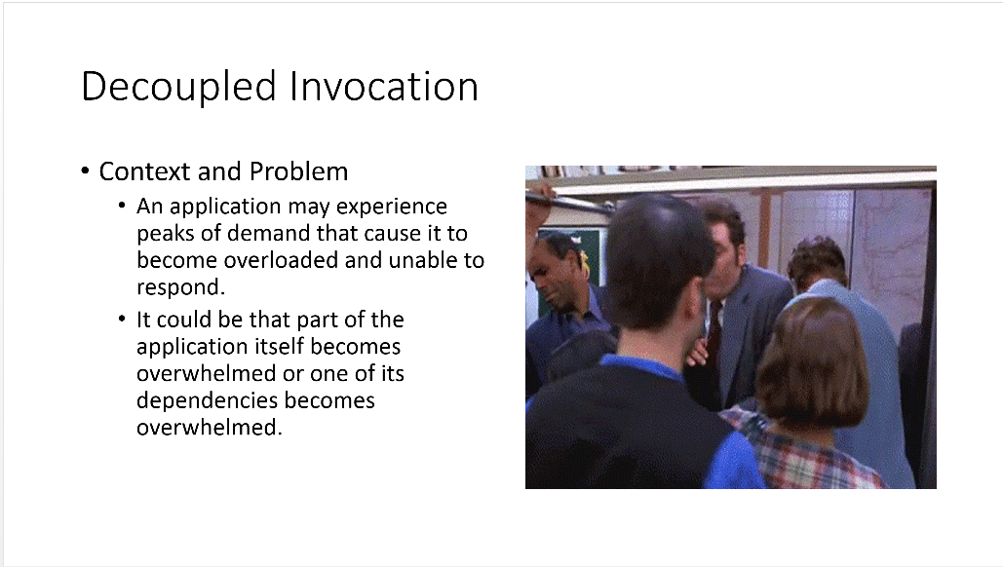
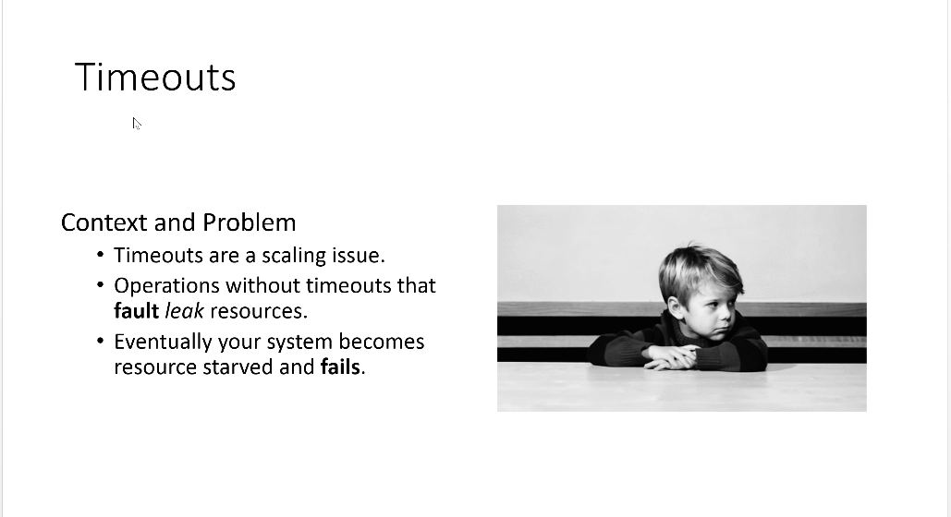
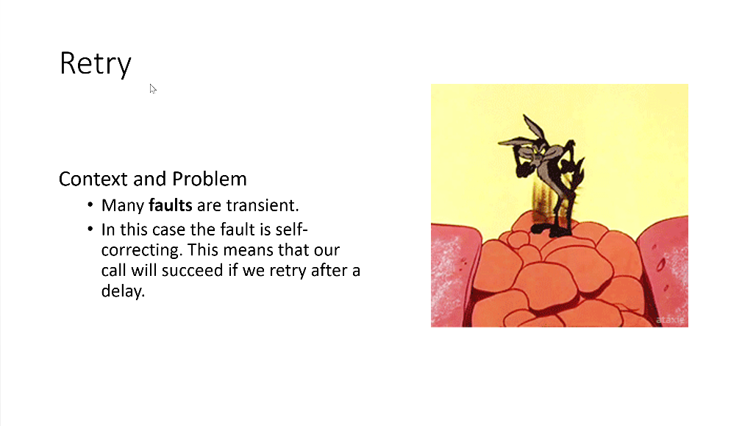
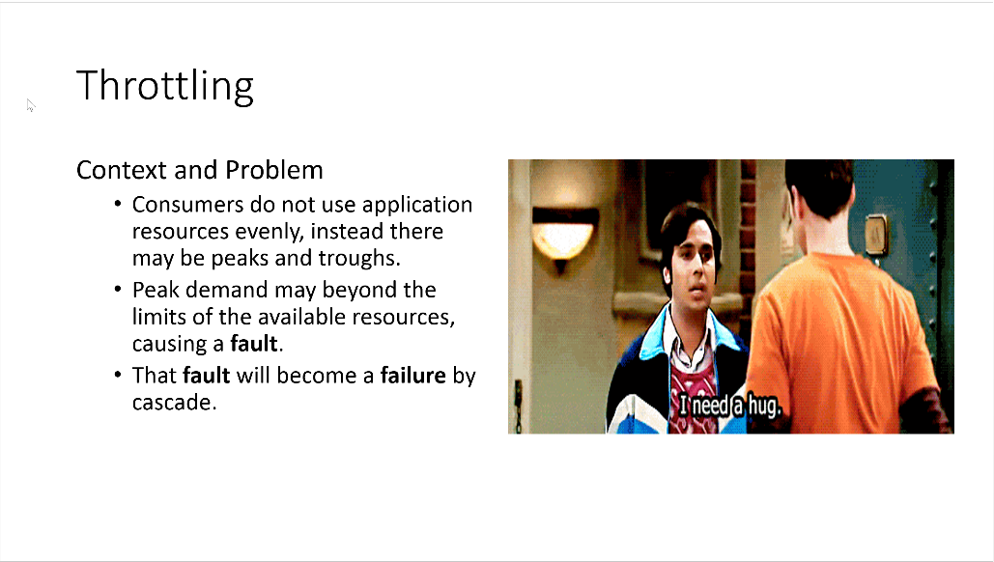
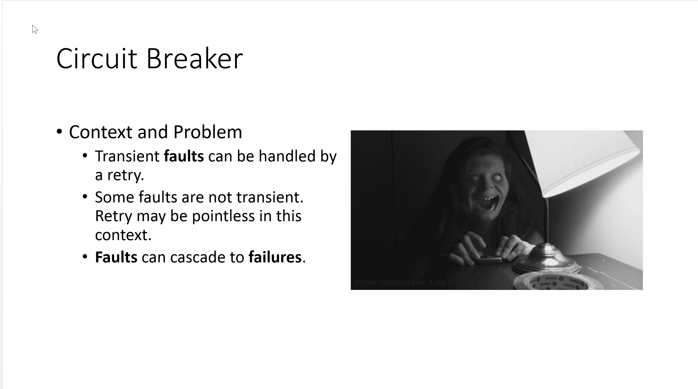

Slide 85
Q&A
Please share your feedback using NDC’s Green, Amber, and Red system.

